Slide 1



E-COMMERCE PRODUCT RECOMMENDATION SYSTEM
MACHINE LEARNING & PREDICTIVE ANALYTICS
FINAL CLASS PROJECT
MAY 23. 2024
Internal use only

Slide 2



BUSINESS PROBLEM
An e-commerce website specializing in beauty products wants to enhance its user experience by developing a dynamic, personalized recommendation system. The system should not be static but should instead adapt to the evolving preferences of its users, providing tailored product suggestions based on user behavior and ratings.
GOALS
Create a recommendation engine that suggests products which these similar users have rated highly but the target user has not yet rated, ensuring personalized and relevant product recommendations.
Develop a method to identify the top 5 users similar to a given user based on their historical ratings, utilizing a well set recommendation system approach

Slide 3
EXPLORATORY DATA ANALYSIS (EDA)
Product Id
User Id
Rating
Year
Month
Normalized Rating
DATA DESCRIPTION
The dataset contains over 2 million customer reviews and ratings of beauty-related products sold on Amazon's website, with 2,023,070 rows. There are 1,210,271 unique users and 249,274 unique products, with ratings ranging from 1 to 5.
DATA
FEATURES
QUALITY CONCERNS
Quality concerns include the presence of outliers, as many users consistently give the highest rating (5), indicating potential bias or spammy behaviour. Data sparsity is another issue, with numerous products having very few ratings, challenging reliable conclusions and recommendation performance. Additionally, some users have only rated a few products, providing insufficient data to establish clear preference patterns. Addressing these issues is crucial to ensuring the robustness of the recommendation system.

Slide 4
ASSYMPTIONS & HYPOTHESIS
ASSUMPTIONS
HYPOTHESIS
Users with similar past ratings will likely have similar future preferences.
By identifying patterns in user ratings, the system can predict future preferences and make relevant recommendations.
Normalizing ratings can help mitigate biases where some users rate consistently higher or lower than others.
Adjusting ratings to a common scale allows for fairer comparison between users and more accurate similarity calculations.
The ratings given by users have enough variability to find meaningful similarities between users.
Range of ratings ensures that the similarity measures capture significant differences in user preferences, leading to accurate recommendations.
Popular products are likely to provide more reliable recommendations than less popular products.
Products with a higher number of ratings have more robust data, making them better candidates for reliable recommendations

Slide 5
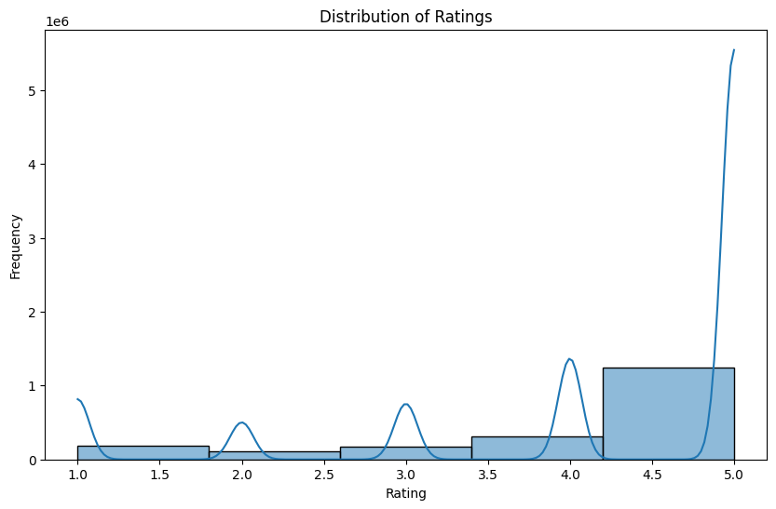
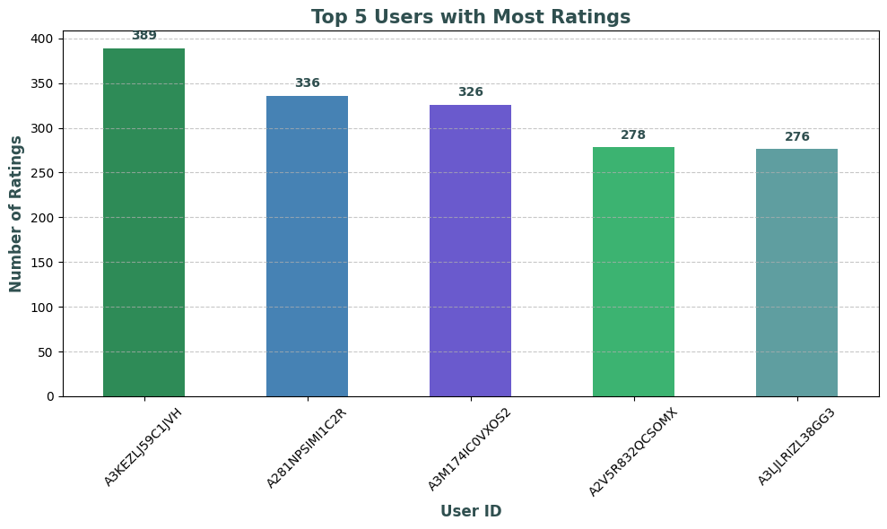
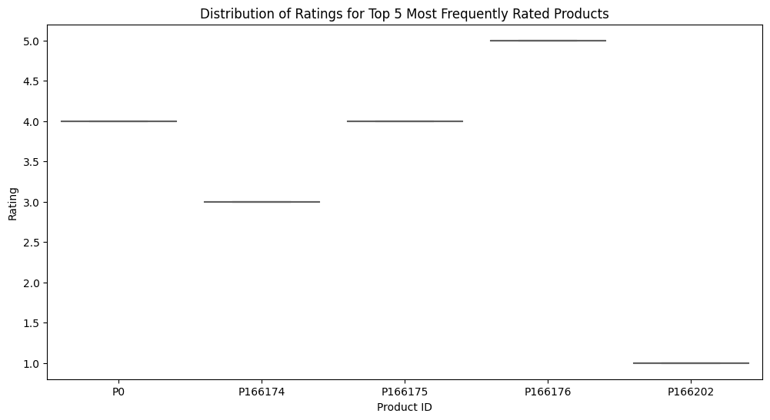
EXPLORATORY DATA ANALYSIS (EDA)
RATINGS DISTRIBUTIONS
TOP 5 USER
TOTAL RATING
TOP 5 USER
RATING BEHAVIOR
The distribution of ratings is skewed towards higher ratings, with the majority being 4.5 and above, indicating a potential positive bias that could affect the reliability of the recommendation system.
The top 5 most active users have provided between 276 and 389 ratings each, significantly influencing the dataset.
The distribution of ratings for the top 5 most frequently rated products shows that each product predominantly received a single rating value. This indicates a lack of variability in the ratings for these products, suggesting that users generally agree on the quality of these items.

Slide 6
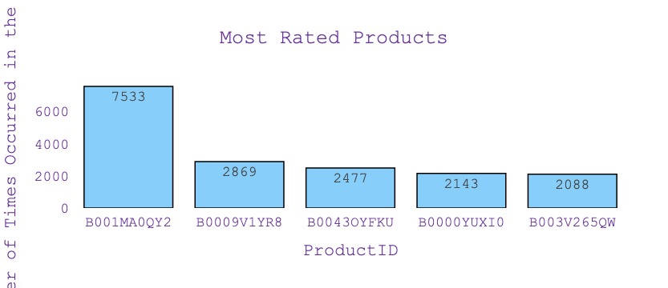
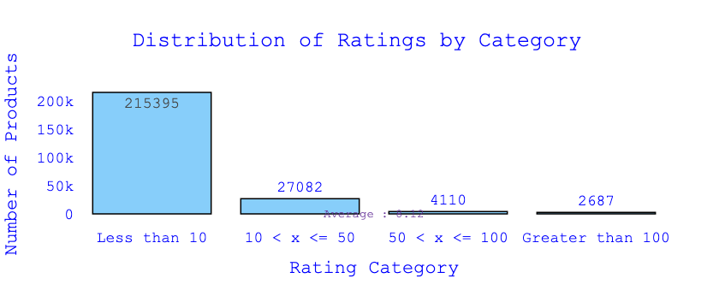
EXPLORATORY DATA ANALYSIS (EDA)
MOST RATED PRODUCTS
DISTRIBUTION RATINGS BY CATEGORY
The most rated product received 7533 ratings, significantly more than the others. The next most rated products have 2869, 2477, 2143, and 2088 ratings, respectively. This indicates a skewed distribution of user ratings, with a few products receiving the majority of attention.
the distribution of ratings by category, with a vast majority of products (215,395) receiving less than 10 ratings. There are 27,082 products with 10 to 50 ratings, 4,110 products with 50 to 100 ratings, and only 2,687 products with more than 100 ratings. This highlights that most products have very few ratings, indicating a high level of data sparsity.

Slide 7






FEATURE ENGINEERING & TRANSFORMATIONS
Timestamp Conversion
Label Encoding
Rating Normalization
Filtering Products by Ratings
Creation of User-Item Matrix:
Made the timestamp data more interpretable and useful for analysis.
Converted UNIX timestamps to readable date formats (Year, Month, Day) to facilitate time-based analysis and trends.
Prepared categorical data for ML algorithms that require numerical input.
So converted alphanumeric IDs to numeric values using label encoding, making the data suitable for similarity calculations and other numerical analyses.
Adjusted ratings to account for user-specific biases and standardize ratings across users.
Normalized user ratings by subtracting the average rating given by each user.
Focused on products with a substantial number of ratings to ensure reliable recommendations.
Filtered out products with fewer than 200 ratings, retaining only those products with a significant number of ratings.
Structured data for similarity calculations and collaborative filtering.
For which created a user-item matrix from the filtered ratings data to apply cosine similarity for identifying similar users.

Slide 8
MODEL SELECTION:
Autoencoder Model To Perform Collaborative Filtering
Data Preparation:
Training
1
Encoded user and product IDs using LabelEncoder.
Created a user-item matrix with users as rows and products as columns.
Split the data into training (80%) and testing (20%) sets.
The size of dataset has changed from 2023070 to 370511
3
Compiled the model with Adam optimizer and Mean Squared Error (MSE) loss function.
Trained the model for 100 epochs with a batch size of 256, using a shuffle strategy to improve generalization.
Validation performed on the test set to monitor model performance.
OVERFITTING
MSE: 0.573
Model Architecture:
Results
2
Encoder Layers :Dense layers with 128, 64, and 32 neurons, each followed by Batch Normalization and Dropout for regularization.
Decoder Layers: Dense layers with 64, 128 neurons, followed by Batch Normalization and Dropout.
4
Encoder Layers :Dense layers with 128, 64, and 32 neurons, each followed by Batch Normalization and Dropout for regularization.
Decoder Layers: Dense layers with 64, 128 neurons, followed by Batch Normalization and Dropout.

Slide 9
MODEL SELECTION:
SVD
Data Preparation:
Training
1
Filtered ratings data is first converted into a format suitable for the Surprise library. The data is loaded into Surprise format by specifying the rating scale, which ranges from 1 to 5. This is accomplished using the Reader class to parse the data, followed by the Dataset.load_from_df method to convert the DataFrame into a dataset.
3
The training process involves hyperparameter tuning to identify the best combination of hyperparameters based on the RMSE. After defining the parameter grid, GridSearchCV is used to find the optimal set of hyperparameters. The dataset is then split into training and testing sets in an 80-20 ratio.
OVERFITTING
RMSE: 1.1984
Model Architecture:
Results
2
Used Singular Value Decomposition (SVD) to perform collaborative filtering. To optimize the model, a grid of hyperparameters is defined for tuning. These hyperparameters include the number of latent factors (n_factors), the number of training epochs (n_epochs), the learning rate (lr_all), and the regularization term (reg_all).
4
To evaluate the performance of the tuned model, we use the test set and calculate the RMSE. The evaluation process involves predicting the ratings on the test set and comparing them with the actual ratings to compute the RMSE.

Slide 10

FINAL MODEL:
Collaborative Filtering - Using Cosine Similarity & KNN
User-Item Matrix Creation:
Pivot the dataset to create a user-item matrix where rows represent users and columns represent products. The values in the matrix are the normalized ratings.
Data Preparation:
Model Architecture:
1
Encoded user and product IDs using LabelEncoder.
Created a user-item matrix with users as rows and products as columns.
Split the data into training (80%) and testing (20%) sets.
The size of dataset has changed from 2023070 to 370511
2
Encoder Layers :Dense layers with 128, 64, and 32 neurons, each followed by Batch Normalization and Dropout for regularization.
Decoder Layers: Dense layers with 64, 128 neurons, followed by Batch Normalization and Dropout.
Cosine Similarity Calculation:
Compute the cosine similarity between users to identify how similar they are based on their product ratings.
Recommendations Generation:
Recommend products to the user based on the products rated highly by the top similar users, ensuring the recommended products are ones the current user has not interacted with.
Top Similar Users Identification:
For a given user, find the top 5 most similar users by sorting the cosine similarity scores in descending order.

Slide 11
FINAL MODEL:
Collaborative Filtering - Cosine Similarities between Users
EXPLANATION OF RECOMMENDATION MODEL
1
Input Parameters
2
User-Item Matrix
3
Mean Ratings
4
Filter & Reco.
Filters the mean ratings of similar users to include only the products that the current user has not rated.
Sorts these products by mean rating in descending order to prioritize higher-rated products, increasing the likelihood that the recommendations will be well-received.
user_id: The target user for whom we want to recommend products.
similar_users: The top 5 similar users to the target user.
similarity_table: The user-item matrix with normalized ratings.
top_recommendations: The number of top product recommendations to return (default is 5).
This step extracts data for products rated by the users who are similar to the target user. This helps us understand what products similar users are engaging with.
Filters the user-item matrix to include only the similar users. This ensures we're working with the right subset of data.
Computes the average rating for each product based on the ratings from the similar users. This helps to determine which products are generally preferred by the similar users.
Retrieves the current user's data and transposes it for easier filtering.
Identifies products that the current user has not rated (where rating is 0).

Slide 12
RESULTS AND LEARNINGS

Slide 13
FUTURE WORK

Slide 14
MARKET RESEARCH & CI OPPORTUNITIES
PROPOSED OFFERINGS
THE IMPACT OF GENERATIVE AI IN MR& CI
KEY MARKET DIFFERENTIATORS AND RISKS
CORE REQUIREMENTS & KEY SKILLS
Q&A
TABLE OF CONTENT

Slide 15



ProcDNA
STRATEGIC LIFE SCIENCES CONSULTING DONE DIFFERENTLY
THROUGH ANALYTICS AND PRODUCTS
We are a full-service,
life-sciences insights & consulting company
built on a foundation of technology & innovation
with a passion for positively impacting how our clients engage with doctors and patients

Slide 16

MARKET RESEARCH OPPORTUNITIES

Slide 17

STAKEHOLDERS & DIRECT CLIENTS FOR PROCDNA
Technical operations
Research & Development
Business Development
Legal
Sales
Marketing
Manufacturing -Procurement, storage, distribution
Drug discovery
&
clinical testing
Regulatory affairs
Medical affairs & compliance
Sales force promotes drugs to healthcare providers
Promotional strategy
&
market research
Licensing
&
Acquisition
PROCDNA KEY CLIENTS
“ Our projects/methodologies can support biopharma/life sciences decision-makers in multiple roles; our typical clients could be concentrated in sales & marketing strategy, aligned with near-to-market or marketed brands & portfolios ”

Slide 18



















LEADING THE WAY: PROCDNA'S COMPREHENSIVE SOLUTIONS FOR THERAPY DEVELOPMENT AND COMMERCIALIZATION
EARLY-STAGE
LATE STAGE
POST-COMMERCIAL
Opportunity Assessment / Knowledge Book
Market Demand / Forecasting Inputs
Patient
Journey
Buying Process
Performance Tracking
Promotional Effectiveness
Patient
Charts
Market Potential Assessment
Market Segmentation
Profiling & Positioning
Creative Concept Testing
Competitor Launch Assessment
Access
Perception & Optimization
Customer Experience
KOL Mapping
Detail Aid Development & Testing
Launch Performance Planning
Product Delivery (Package / Device)
Secondary Data Analytics & Integration
INITIAL MARKET RESEARCH CAPABILITIES

Slide 19




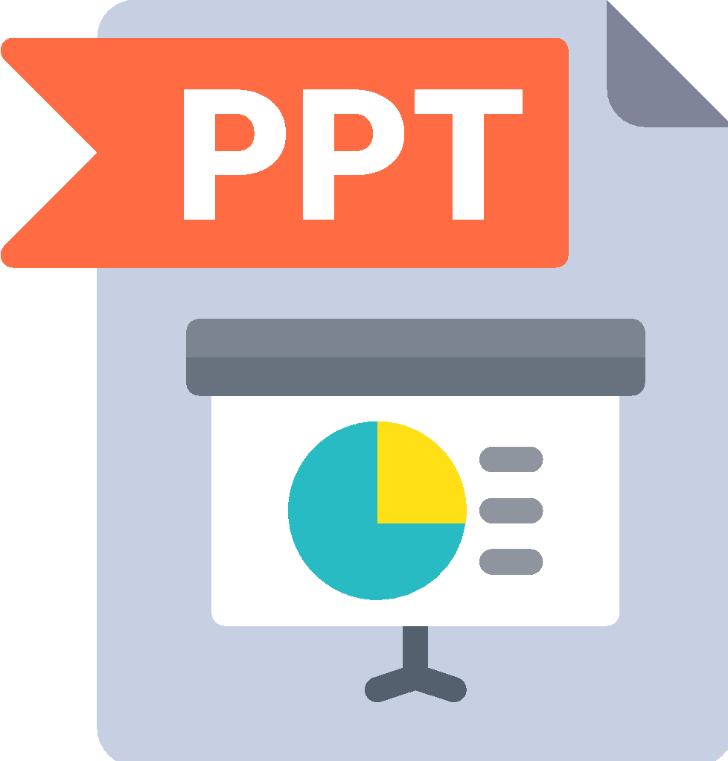
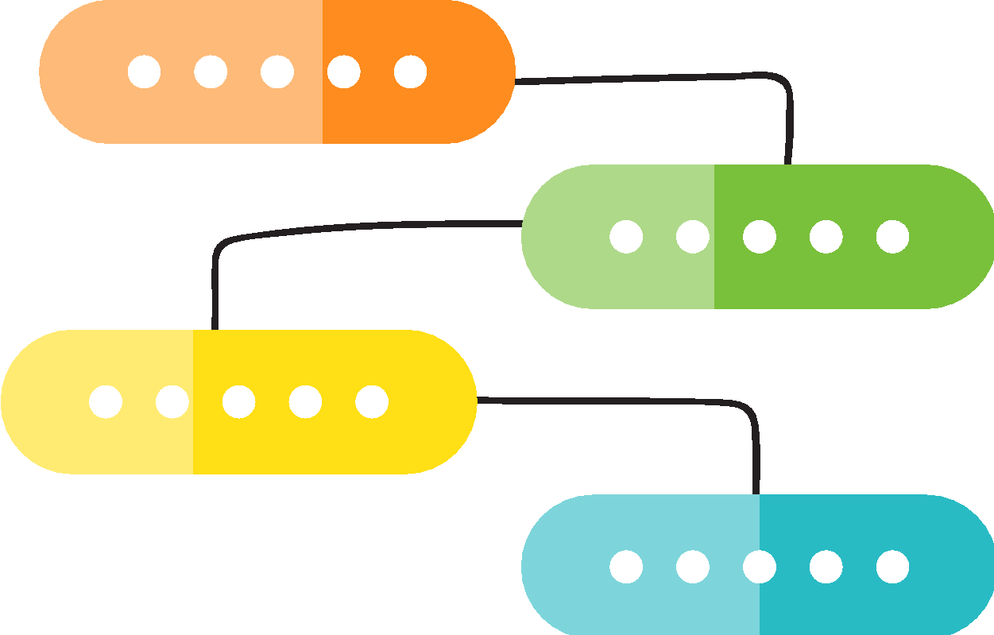

NEW DIMENSIONS IN MR: HOW PROCDNA TRANSFORMS QUANTITATIVE & QUALITATIVE MARKET RESEARCH
Strategic
Narrative Building
Full PPT / Dashboard Deliverable
Survey
LIVE
Dashboard
LIVE
First Client Meeting
Story Refinement / Deeper Dives
TRADITIONAL
PROCESS
Story Refinement / Deeper Dives
Survey
LIVE
Survey
CLOSE
Full PPT Deliverable
First Client
Meeting
Strategic Narrative Building

Slide 20
PROPOSED OFFERINGS

Slide 21



1
Perception Performance Tracking
ProcDNA could establish launch KPI measurements, measure pre- and post-launch product awareness and perceptions, ongoing tracking of performance on KPIs (ATU, brand equity, promotional effectiveness), capture real-world dialogues between MDs and patients
[PRODUCT] Non-User
Disease Beliefs to understand the broad unmet needs and decision drivers in the AD market
Understand detailed view of current and future usage behavior
Awareness of both approved and in development treatment options, as well as engagement in disease management
Product Beliefs to understand performance of products along the key attributes
[PRODUCT] User

Slide 22
1
Perception Performance Tracking
Important value proposition for our client when it comes to tracking a products perception among HCPs
Awareness
Beliefs & Perceptions
Drivers & Barriers
HCP Trial & Usage
Assess awareness levels for therapies and track awareness
Measure key disease beliefs that will lead to Pfizer brand growth. This will include market context and an in-depth indication dynamics
Identify attributes that will lead to or prevent maintenance of share or share growth – both intrinsic product factors and extrinsic market factors – and points of differentiation for [PRODUCT]. This will include understanding the hierarchy of attributes and product performance
Understand anticipated physician behaviors, including adoption rate, and identify key target patient types

Slide 23
1
Perception Performance Tracking
Along with identifying the key factors to prescription, this offering can be used to understand the segmentation of physicians and their prescribing pattern along with factors hindering them to fall under the anticipated segments
Hidden Motivators
Critical Motivators
Drivers Map – Critical & Hidden Drivers
Stated importance can be obtained via Max-Diff, in which respondents tell us which attributes are most and least important.
Derived importance measures statistical strength of association between an overall measure (e.g. motivation to seek information) and performance attributes for available treatments.
Low HCP burden for reimbursement
Safety
Relationship with rep
High ORR
Low OOP cost for patients
Well-tolerated by patients
DERIVED IMPORTANCE
Patient buy-in
Segmenting Physicians – Subgroup Analysis
Comprehensive profile of likely /early adopters
Analysis by existing segments, physician targets
Analysis by academic/community settings etc.
Lowest Impact
Non-deal breakers
Offers co-pay and patient assistance
Method of Admin
STATED IMPORTANCE

Slide 24

1
Perception Performance Tracking
EXAMPLE
SITUATION:
The client operated in a rare-disease space where therapies were far and few between, and the barriers to access were high. The client had two products for treatment of the disease and wanted to understand key challenges that patients faced, and ultimately cater to both acute and prophylactic treatment of the disease without cannibalizing shares of either client product.
Key Questions Included:
What therapies do patients prefer to help treat acute conditions vs. for prophylactic treatment? What share of acute attacks of the disease are treated using the client product?
Why do patients prefer to use the clients’ product vs. competitors’ product to treat acute attacks of the disease / for prophylactic treatment?
With Our Offering:
With a robust data of treaters from the data vendors we can deploy a 20-minute performance tracking survey to assess product preferences among patients, and to better understand key challenges that patients face, ultimately helping the client prioritize their two brands without cannibalizing shares
EXAMPLE FINDINGS:
1
Understood that patients mostly treated their disease acutely, with the client’s product for acute treatment being used to treat ~70% of attacks month on month
Identified that patients preferred the client’s product for acute treatment irrespective of the severity of attack, and that the prophylactic treatment being used had no bearing on the acute treatment used
Isolated barriers to treatment and reasons for patients to switch to other therapies: patients were looking for easier routes of administration and / or easier access to treatment
2
3

Slide 25









2
Sales Force & Messaging Effectiveness
PROMOTIONAL ACTIVITY
REP-DRIVEN / PERSONAL PROMOTION
NON-PERSONAL PROMOTION
HCPs REPORT ALL RECENT PROMOTIONS
HCPs REPORT DETAILS OF RECENT REP INTERACTIONS
HCPs REPORT ON NPP CAMPAIGNS WHILE THEY ARE TOP OF MIND
Survey where HCPs recall all the personal and non-personal promotions they have received in the past month / week
Survey where HCPs recall all the interaction details and the specifics of the interaction they just had with the rep
Survey where HCPs recall details of non-personal promotions that they saw and the specifics of the promotional material that they just reviewed
This survey is always on. HCPs are encouraged to report recent promotions each time they enter the ProcDNA system. This facilitates reporting just after the promotion.
This survey will help you get a full picture of every detail from recent rep-led interactions
This survey will help you get comprehensive insights on non-personal promotional channels that are top-of-mind for HCPs and those that are most preferred

Slide 26


2
Sales Force & Messaging Effectiveness
ProcDNA to investigate the opportunity within competitive context for differentiation, value proposition generation, optimal positioning approach, messaging and communication development, detail aid development and sales representative impact
Share of Voice
Recall / Retention
Rep Utility
Other Metrics
Rep Reach
Frequency of visits
Share of Voice & Attention
% of multi-product details
Aided Recall
Unaided Recall
New information
Key Takeaway
‘Stickiness’ (Message resonates from On-Demand ->Monthly)
Knowledge
Follow-ups
Satisfaction (Informative)
Resourceful (collateral, samples, use of visual aids)
Competitor metrics
Competitor metrics – delivery effectiveness
Performance of individual field forces (in case of multi-FF detailing)
Regional and decile level data (as specified)

Slide 27
2
Sales Force & Messaging Effectiveness
EXAMPLE
SITUATION:
An oncology manufacturer is promoting multiple products for various patient types within breast cancer. Reps split call time across 3+ products and need to maximize the time spent with oncologists.
Key Questions Included:
How well are reps prioritizing these products & sub-indications?
Are the new product messages resonating with oncologists?
With Our Offering:
Surveying 100+ oncologists from the client’s target list per quarter, we were able to capture rep activity and time spent at the product-level. Message and rep ratings were captured across a robust set of MDs.
EXAMPLE FINDINGS:
1
Reps are prioritizing the newest product / indication over more long-standing products and it is having positive outcomes
Oncologists recall more high-priority messages when the newest indication is discussed first during interactions
Reps are also rated higher in terms of overall quality when the newest indication is discussed
Rep-MD discussions focus primarily on the new indication message while the PFS message is under-delivered
MDs find the PFS message to most motivating to prescribe, but it is delivered in less than half of all interactions
2

Slide 28
3
Patient Chart Analysis
ProcDNA could collects real-time patient charts from HCPs and the continuous fielding helps to capture treatment decisions quickly; The charts will collect deep-dive information on treatment decisions and rationale for each patient
PRIMARY OBJECTIVES
SECONDARY OBJECTIVES
Helps measure several performance components such as:
Adherence to clinical protocols
Patient adherence with medication regimens
Provider compliance with coding and documentation requirements
Plays a pivotal role in quality improvement. Helps determine what has been done, and see if it can be done better
Gain insights into patient and prescriber segmentation that drives treatment choices
Gauge patient agency in treatment discussions and decisions
In some cases, augment PERFORMANCE TRACKING and/or secondary data which does not completely capture market dynamics

Slide 29
3
Patient Chart Analysis
Impactful Metrics that could be captured in a patient chart analysis offering
Patient Demographics
Treatment & Disease History
Patient Management
Patient Interaction Details
Age
Gender
Comorbidities
Lifestyle
Insurance type
Severity
Disease progression history
Treatment history
Treatments
Duration
Response
Treatments prescribed previously
Other treatments considered
Rationale behind choosing one type of treatment
Criteria considered to prescribe combination therapy
Management of treatment side effects / toxicity
Drivers and barriers of decision (QUALITATIVE)
Topics discussed with patient (QUALITATIVE)
Patient role in decision (patient request) (QUALITATIVE)
Patient questions / concerns with treatment (QUALITATIVE)

Slide 30
3
EXAMPLE
Patient Chart Analysis
SITUATION:
Client sought to use a chart audit study to better understand the positioning of and threat posed by oral competitor, BRAND B, in the rheumatoid arthritis market
Key Questions Included:
How is their company product being prescribed to the patients in the line of therapy for adolescents?
Are there any direct risks associated from the competitors in the LoT given their product has been in the market for a while
With Our Offering:
Taking into account the data that we could source from secondary providers, such as IQVIA, Symphony; we could collect the information of an HCPs pattern in prescribing the products along with the prescription pattern from the past AUXO information
EXAMPLE FINDINGS:
Most CLIENT BRAND patients had failed at least 1 biologic previously
Efficacy drove MD prescribing; oral formulation & efficacy drove patient preference.
CLIENT BRAND captured share from early- and later-line therapies, along with BRAND B, established in the RA market is catching up with it’s new treatment plan and product to take the share of voice of the product

Slide 31


PROPOSED - ROADMAP FOR THE OFFERINGS
Proposed roadmap that we can pitch to the clients to enable a seamless track of deliverables for the clients to understand about the product post-commercialization
Month
1
2
3
4
5
6
7
8
9
10
11
12
Patient Chart –
quarterly reporting
Performance Tracking - quarterly reporting
Sale Force & Messaging – monthly reporting

Slide 32
THE IMPACT OF GENERATIVE AI IN REVOLUTIONIZING
MARKET RESEARCH

Slide 33
GENERATIVE AI INVOLVEMENT IN EACH PHASE OF A MARKET RESARCH AND CI SPACE
Data Collection
Data Analysis
Visualization & Reporting
The use of AI in chat-based surveys and virtual worlds hints at a transformative shift in data collection, improving organizational efficiency.
Generative AI, through techniques like GANs, can create synthetic data for market research, providing cost-effective alternatives to expensive primary research efforts.
AI can analyze large volumes of unstructured text, audio, and video data of competitors, facilitating scalable insights and summaries, which is especially beneficial in qualitative research.
The technology also offers potential in enhancing model selection and deployment processes, although these applications are still developing towards large-scale adoption.
Generative AI facilitates rapid insight summarization and enhances data-based storytelling, accelerating the reporting process.
Utilizing GPT-based image generation tools like Dall-E can greatly improve visualization and visual-based reporting, making insights more accessible and engaging.

Slide 34
REVOLUTIONIZING MARKET RESEARCH WITH GENERATIVE ADVERSARIAL NETWORKS (GANS)
Generative Adversarial Networks, or GANs consist of two neural networks, a generator and a discriminator, which are trained simultaneously through adversarial training. The generator creates new data instances, while the discriminator evaluates them for authenticity.
Data Augmentation
Consumer Behavior Simulation
Sentiment Analysis and Feedback Generation
Competitor Analysis
GANS enhance market research by generating synthetic data that augments real datasets, particularly when acquiring large, diverse real data is difficult.
Enable businesses to simulate realistic consumer behaviors and responses, helping to refine pharma product launches by generating synthetic datasets from historical data, thus reducing trial & error risks
GANs can be trained on vast to generate realistic patient reviews, comments, and feedback. This synthetic data aids in sentiment analysis, helping clients gauge patient opinion and refine their products or services based on simulated customer reactions
Mimics competitor products and strategies, enabling them to simulate competitive scenarios, test responses, and strategize effectively, thereby enhancing understanding of the competitive landscape and anticipating competitor moves

Slide 35
LEVERAGING GENERATIVE AI FOR SEAMLESS AND CUSTOMIZABLE QUANT RESEARCH AT PROCDNA
TOTAL UNDUPLICATED REACH AND FREQUENCY (TURF)
MAXIMUM DIFFERENCE SCALING(MAXDIFF)
KEY DRIVER ANALYSIS
NET PROMOTER SCORE
Using GenAI TURF analysis will identify which portfolio of items products to the greatest number of prescriptions with past claims data.
It’s used to understand which products are prioritize by asking respondents to make tradeoffs between the benefits and Efficacy Factors.
NPS provides insights into general customer satisfaction by directly measuring how likely a company, product, or service is to be recommended.
Key Driver Analysis is used to determine how important various drivers (e.g. safety, efficacy) are to an outcome, such as brand liking or presecription intention.
Application
Application
Application
Application
Customizable real-time simulator
Pre-defined analyses for various questions
Provides automatic suggestions for optimal survey designs
Gamified approach for respondents
Flexibility to choose multiple outcomes and drivers
Easy to understand visualizations with clear recommendations for action
Allowing respondents to drag and drop the method into their survey in seconds and watch results in real-time.

Slide 36
KEY MARKET DIFFERENTIATORS AND RISKS IN LAUNCHING AN MR & CI DOMAIN

Slide 37






KEY DIFFERENTIATORS WITH COMPETITORS WHEN IT COMES TO PROVIDING ADVANCED MARKET RESEARCH SOLUTIONS
PROPOSED DIFFERENTIATOR WITH OTHER MARKET RESEARCH COMPANIES
Immediate data collection approach and AI survey structure that allows for capturing nuanced sales force and HCP dynamics
Customized approach that fits client’s immediate business needs with tailor made survey changes
Dedicated client teams would empower them to be more agile and flexible in the research
OTHER
RESEARCH PLATFORM | Fully custom | Fully syndicated
PHYSICIAN PANEL | Given the experience in vendor management, easy procurement of data Relevant sample recruited from your target list, key segments, etc. | HCPs on the panel could be sourced from multiple vendors Minimal tailoring to your target list
COMPLEXITY AND NUANCE | Complexity of multiple products, indications, co-promotion, etc. Tailored survey platforms | Syndicated approach yields analysis that is sub-optimal in complex situations
REPORTING APPROACH | Custom study design that nimbly adjusts to changing market dynamics Additional & robust ad-hoc analysis and reporting Integration with secondary data sources (claims, CRM, etc.) | No tailoring; syndicated report No incorporation of your HCP segments, sales regions, CRM, etc. No option to build on the research
TRACKING NATURE | The custom nature of the study allows teams to test their “in-the field” proprietary brand messages | Syndicated nature of the study forces teams to test for generalized messaging reducing the ability to get actionable data

Slide 38
RISKS AND MITIGATION STRATEGIES FOR LAUNCHING MARKET RESEARCH AT PROCDNA
Client Adoption
Pricing Strategy
Integration with Existing Services
Scaling & Dependent on 3rd Party Vendors
Educating existing clients on the benefits of ProcDNA's market research services would require a steep runway
Offering multiple syndicate studies to provide an assurance to client for understanding our capabilities and portfolio
Develop case studies and testimonials tailored to the specific needs of existing client segments.
Conduct research to understand pricing models used by competitors and the willingness of potential clients to pay or convincing for GenAI synthetic data
Offer flexible pricing options to cater to different offering budgets and client needs along with our products such as AUXO
Carefully plan the integration of market research services with existing offerings to avoid operational inefficiencies and associated cost factors
Ensure that new services complement and enhance ProcDNA's existing portfolio, strengthening the overall value proposition for clients as compared to competitors
Thoroughly assess and select vendors based on their capabilities, track record, and alignment with ProcDNA's business requirements to mitigate risks related to cost, quality, and reliability.
ProcDNA must strategically plan and manage the challenges of scaling its market research operations, including infrastructure, workforce, and processes

Slide 39
CORE REQUIREMENTS & KEY SKILLS

Slide 40
BLUEPRINT FOR SUCCESS: KEY PRIORITIES AND SKILLS FOR PROCDNA'S MARKET RESEARCH & CI EXPANSION
Core Requirements
Key Technical Skills
Analytical and Statistical Skills
Establishing robust mechanisms for data collection, storage, and analysis is critical. Investing in or developing sophisticated data analytics tools and technologies and ensuring data accuracy and reliability along with CI capabilities
1
Proficiency in statistical analysis remains crucial, but should also include knowledge of AI-driven analytics, such as using machine learning models to predict trends and outcomes in healthcare data. Skills in programming languages like R, Python, and familiarity with AI frameworks and libraries are essential.
Data Collection and Management Capabilities
Therapeutic Area Expertise
2
Therapeutic area expertise in healthcare consulting involves deep knowledge of specific medical domains, allowing consultants to deliver precise, evidence-based insights and strategies tailored to unique health conditions and treatments.
Building strong relationships with existing ProcDNA clients by understanding their specific needs and delivering tailored insights. This might require sector-specific expertise in understanding the
Quant and Qualitative Research Exp.
Client Engagement and Business Development
3
Experience in quantitative and qualitative research equips professionals with the ability to gather, analyze, and interpret both numerical data and subjective information, enhancing comprehensive insights in market research along survey designing skills.
Understanding and adhering to regulations (like HIPAA in the U.S) is crucial. Ensuring compliance in data handling, patient privacy, and ethical research practices is foundational.
Generative AI Expertise
4
Specific expertise in Generative AI enables the application of models like GANs and NLP tools to simulate outcomes, generate new data, and provide deeper, predictive insights in healthcare market research.
Compliance and Ethics

Slide 41
Email
praveenn@uchicago.edu
Q & A
LinkedIn
https://www.linkedin.com/in/praveen-n-m/
Phone
872-904-1287

